Slide 1









TEXT ANALYTICS Sentiment Analysis II Document Similarity & Applications Fall 2019 (Nov 6, 7)
Dr. Anitesh Barua
David Bruton Jr. Centennial Chair Professor of Business
Distinguished Fellow, INFORMS Information Systems Society
Stevens Piper Foundation Professor
University of Texas Distinguished Teaching Professor
McCombs School of Business, University of Texas at Austin
Email: aniteshb@gmail.com

Slide 2
Supervised Sentiment Analysis
Same as classification or prediction with text
Start with a collection of documents whose sentiments are known (i.e., they have been labeled manually)
Many approaches are possible – from the naïve to the sophisticated
Unigrams or “bag-of-words” for starters – single words, assumed to occur independently of each other in a document

Slide 3
Simplest Approach to Sentiment Analysis?
“It’s rather like a lifetime special – pleasant, sweet and forgettable.”
Positive reviews in
training data: 15 occurrences
Negative reviews: 6
Goodness score:
Badness score:
Positive: 46
Negative: 22
Goodness score:
Badness score:
Positive: 10
Negative: 14
Goodness score:
Badness score:
Positive: 506
Negative: 507
Goodness score:
Badness score:
Source: https://www.youtube.com/watch?v=0JsHvXmU0dA

Slide 4
Calculations
Words | #Positive | #Negative | Goodness | Badness
it’s | 506 | 507 | .5 | .5
rather | 42 | 63 | .4 | .6
like | 242 | 396 | .61 | .39
a | 3446 | 3112 | .53 | .47
lifetime | 3 | 5 | .38 | .62
special | 29 | 40 | .42 | .58
sweet | 15 | 6 | .71 | .29
pleasant | 46 | 22 | .68 | .32
and | 3198 | 2371 | .57 | .43
forgettable | 10 | 14 | .42 | .58
SCORE |  |  | 5.22 | 4.8

Slide 5
Top-10 Words
Positive | Negative
riveting | unfunny
gem | badly
engrossing | poorly
vividly | flat
wonderfully | bore
polished | pointless
lively | offensive
heartwarming | plodding
startling | product
spare | disguise
Source: https://www.youtube.com/watch?v=0JsHvXmU0dA

Slide 6
Tough to Detect
This movie makes Catwoman look like a great movie
A terrible movie that some people will nevertheless find very moving
Well made but mush-hearted
Your children will be occupied for 72 minutes
Source: https://www.youtube.com/watch?v=0JsHvXmU0dA

Slide 7
K-Nearest Neighbors
Instead of comparing individual words in the training set, consider entire reviews.
Find “nearest” reviews
Example
Classify as positive or negative:
“It’s rather like a lifetime special – pleasant, sweet and forgettable”
Find “most similar” review(s) in the training set
“I liked this movie, made for a pleasant evening” (Class = positive)
“This movie was such a bore” (Class = negative)
Source: https://www.youtube.com/watch?v=0JsHvXmU0dA

Slide 8
The Difference
BEFORE
NOW
it’s
sweet
it’s
sweet
special
special
rather
pleasant
rather
pleasant
compare
TRAINING SET
BAGS
Source: https://www.youtube.com/watch?v=0JsHvXmU0dA

Slide 9
Compare with Reviews in Training Set
Task: To determine the sentiment of
“It is a surprisingly funny movie!”
[surprisingly, funny, movie]
A review in the training data labeled as Positive:
“funny movie, I recommend it.”
[funny, movie, recommend]
Source: https://www.youtube.com/watch?v=0JsHvXmU0dA

Slide 10
How do we Quantify the Distance?
[surprisingly, funny, movie]
“funny” occurs in, say, 10%
of all reviews
“movie” occurs in, say,
70% of all reviews
[funny, movie, recommend]
Need to know frequencies of matching words in the training data
SCORE= 1/0.1 + 1/0.7 = 10 + 1.43
= 11.43
Source: https://www.youtube.com/watch?v=0JsHvXmU0dA

Slide 11
Importance of Words
Classify
“Enigma is a surprisingly engaging movie”
One review from training set
“Enigma is a movie that engrosses you, I recommend it.”
More info: “Enigma” occurs .001 (1 in 1000 times)
“Engage/engross” occurs .3 (30% of all training set reviews)
“Movie” occurs .7 (70%)
How do we create a similarity score?
Source: https://www.youtube.com/watch?v=0JsHvXmU0dA

Slide 12
Add a Little Twist ….
[Enigma, surprisingly, funny, movie]
Occurs in,
say,0.001
of all reviews!
[Enigma, funny, movie, recommend]
SCORE= 1/0.001 + 1/0.1 + 1/0.7
= 1000 + 10 + 1.43
= 1011.43
Source: https://www.youtube.com/watch?v=0JsHvXmU0dA

Slide 13
Not all Words are Created Equal
[Enigma, surprisingly, funny, movie]
[Enigma, funny, movie, recommend]
SCORE= log(1/0.001) + log(1/0.1) + log(1/0.7)
= log(1000) + log(10) + log(1.43)
= 3 + 1 + 0.15 = 4.15
Source: https://www.youtube.com/watch?v=0JsHvXmU0dA

Slide 14
Document Similarity & Applications (i) Resonance Analysis (ii) Crowdsourced Recommendation Systems

Slide 15
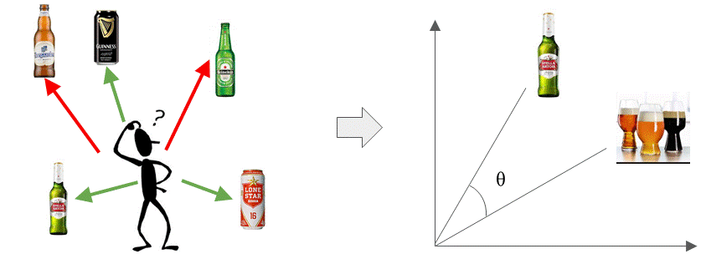
Assessing Document Similarity
Needed for document clustering/categorization & retrieval
Many business applications
E.g., which beers or movies are similar?
Useful for recommendation systems – both conventional & crowdsourced
Understanding your competition in markets with lots of products
Did a campaign resonate with the intended audience?

Slide 16
The Basic Idea
Start with a numerical representation of each document
Many ways to represent a document with numbers
Presence absence of each term (0/1)
Raw or scaled (normalized) frequency of each term
TF-IDF of each term in a document
Two choices to calculate similarity between the documents
Choice 1: Calculate Euclidean distances between documents
Choice 2 (better): Calculate the angle between the two document vectors

Slide 17
Choice 2: Angles Instead of Distances
n-dimensional space with n terms
A document (e.g., tweet) represented
by its coordinates in this term space
t ₂
d ₂
Doc 2
Term 2
d ₁
Doc 1
θ
t ₁
Term 1
t _{n}
Similarity between documents d₁ and d₂ (could also be a set of keywords) is the cosine of the angle Ɵ between them.
Score between 0 and 1.
Source: http://pyevolve.sourceforge.net/wordpress/?p=2497

Slide 18
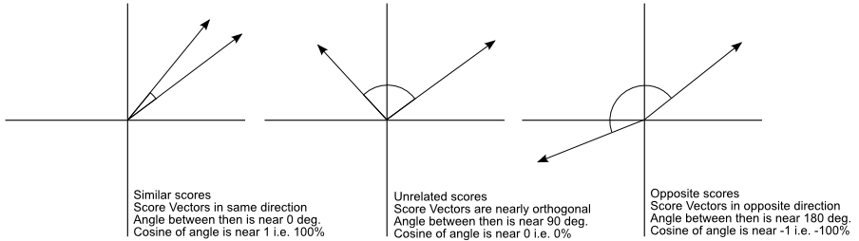
Similar vs. Unrelated Mentions
Ref document
or keywords
Social mention
Is this approach better than Euclidean distances?
Source: http://pyevolve.sourceforge.net/wordpress/?p=2497

Slide 19


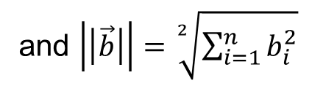
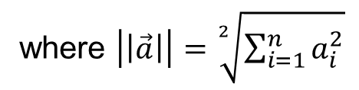

Basics Revisited…
Dot product of two vectors
$$\vec{a}.\vec{b}= \sum_{i=1}^{n}{a_{i} b_{i}}$$
n features, a_{i} and b_{i} could be tf, tf-idf, or other scores
But what exactly does a dot product mean geometrically?
$$\vec{a}.\vec{b}=|\left|\vec{a}\right||∗|\left|\vec{b}\right||∗cosθ$$
where $\left|\left|\vec{a}\right|\right|=\sqrt[2]{\sum_{i=1}^{n}{a_{i}^{2}}}$
and $\left|\left|\vec{b}\right|\right|=\sqrt[2]{\sum_{i=1}^{n}{b_{i}^{2}}}$
$$Or cosθ=\frac{\vec{a}.\vec{b}}{|\left|\vec{a}\right||∗|\left|\vec{b}\right||}$$

Slide 20
In Practical Terms ….
Cosine of angle between two vectors represented by documents d_{j} and d_{k}.
The denominator involves the lengths of the vectors.
What is the key advantage of cosine similarity over Euclidean distance?

Slide 21
Useful for Information Retrieval as Well
Term frequencies
TF | D1 | D2 | D3 | D4
Who | 0 | 0 | 1 | 1
Wrote | 0 | 0 | 0 | 1
Wild | 1 | 1 | 1 | 1
Boys | 1 | 1 | 0 | 0
IDF = log(N/DF)
=log₁₀(4/2)=.301
.602
0
.301
query = ‘who wrote wild boys’
doc1 (D1) = ‘Duran Duran sang Wild Boys in 1984.’
doc2 (D2) = ‘Boys don’t remain wild forever.’
doc3 (D3) = ‘Who brought wild flowers?’
doc4 (D4) = ‘It was John Krakauer who wrote In to the wild.’
Weights based
on document
frequency
Final TF_IDF weights
TF_IDF | D1 | D2 | D3 | D4 | Q
Who | 0 | 0 | .301 | .301 | .301
Wrote | 0 | 0 | 0 | .602 | .602
Wild | 0 | 0 | 0 | 0 | 0
Boys | .301 | .301 | 0 | 0 | .301
Similarity | D1 | D2 | D3 | D4
Query | .408 | .408 | .408 | .913*
Similarity(Doc1,Query) = (0+0+0+.301^2) / [(.301^2)^.5 * ((.301^2 + .602^2 + .301^2)^.5)]
= .0906 / (.301*.7373) = .408

Slide 22
Application 1: Assessing Relevance and Resonance
How do we know if our campaign/message is having an impact on what people are talking about?
E.g., political campaign
Product or brand campaign
How companies describe themselves vs. how employees feel
A simple approach: How “far” are the social mentions from the message?

Slide 23
Application 2: Crowdsourced Recommendation Systems
Matching products with customer preferences
The case of hotel search
Web sites (e.g., hotels.com, orbitz.com, Tripadvisor.com) show by one criterion
Rating
Stars
Location
Price
But most customers consider multiple attributes
How can we provide a better match with customer preferences?

Slide 24
A Lot Better than a Single Criterion
Obtain user inputs, e.g.,
Romantic, ambience, mid-priced, beachfront
Business, budget, wi-fi, convenience
Crowdsource!
Extract large # conversations about hotels
Now becomes a document retrieval problem
E.g., query: ~Romantic ~ambience ~mid-price ~beachfront
Calculate cosine similarity between query & mentions
Rank mentions by cosine similarity (0-1)
Perform sentiment analysis to find most positive reviews
Make recommendations

Slide 25
Additional Data
Augment text with:
Vicinity: E.g., Microsoft Virtual Earth Interactive SDK (software development kit)
Proximity: “near a beach”, “near downtown”, “near public transportation” with user geotagging & automatic classification of satellite images of areas near each hotel (e.g., geonames.org)
Additional information become extra dimensions for cosine similarity analysis
Overall results: Far superior to those provided by ANY of the major hotel search sites

